Slide 1
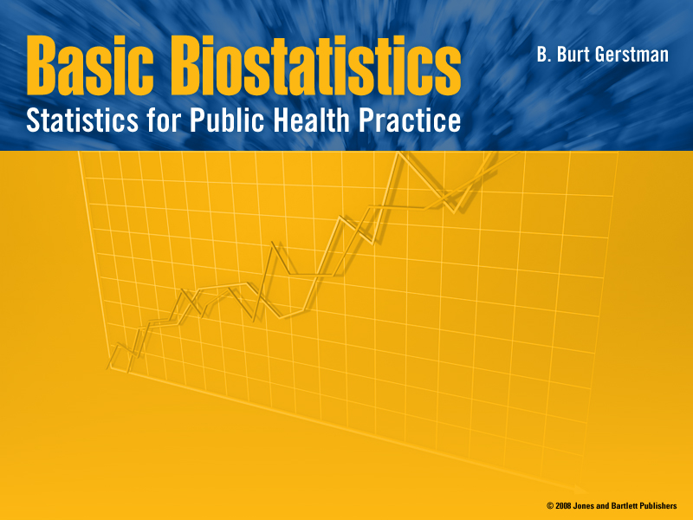
Chapter 15:
Multiple Linear Regression
Basic Biostat
15: Multiple Linear Regression
Notes:
Chapter 15
Basic Biostatistics

Slide 2

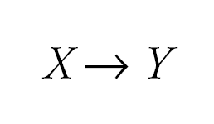
15.1 The General Idea
Simple regression considers the relation between a single explanatory variable and response variable
Basic Biostat
15: Multiple Linear Regression

Slide 3
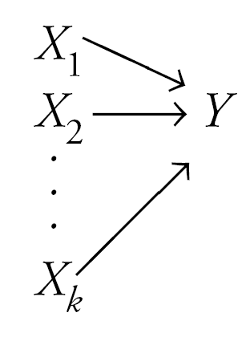
The General Idea
Multiple regression simultaneously considers the influence of multiple explanatory variables on a response variable Y
The intent is to look at the independent effect of each variable while “adjusting out” the influence of potential confounders
Basic Biostat
15: Multiple Linear Regression

Slide 4
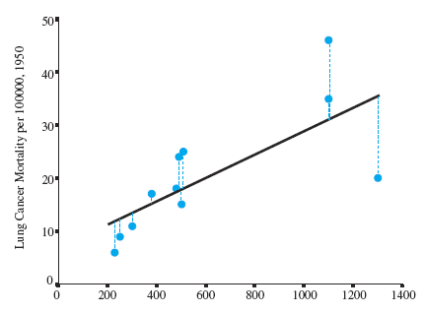
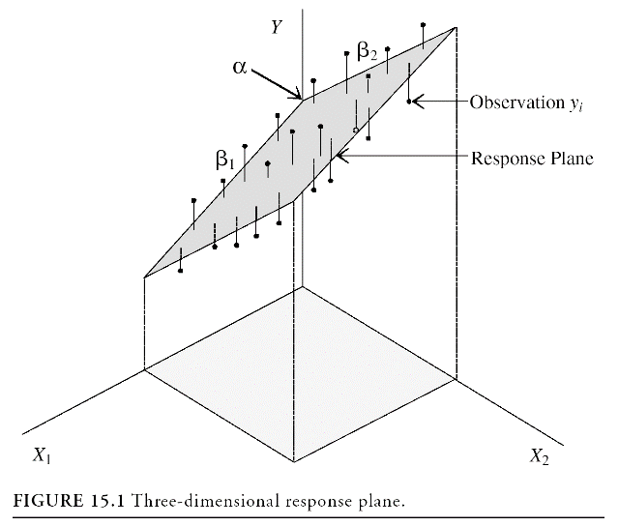
Regression Modeling
A simple regression model (one independent variable) fits a regression line in 2-dimensional space
A multiple regression model with two explanatory variables fits a regression plane in 3-dimensional space
Basic Biostat
15: Multiple Linear Regression

Slide 5
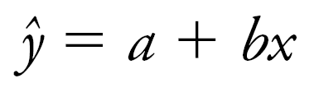
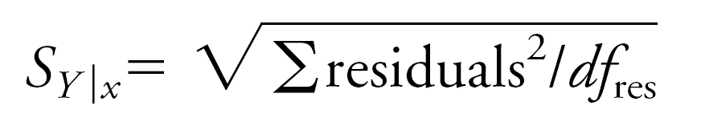
Simple Regression Model
Regression coefficients are estimated by minimizing ∑residuals² (i.e., sum of the squared residuals) to derive this model:
The standard error of the regression (s_{Y|x}) is based on the squared residuals:
Basic Biostat
15: Multiple Linear Regression

Slide 6
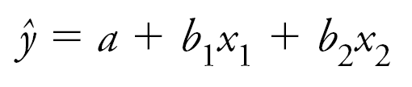
Multiple Regression Model
Again, estimates for the multiple slope coefficients are derived by minimizing ∑residuals² to derive this multiple regression model:
Again, the standard error of the regression is based on the ∑residuals²:
Basic Biostat
15: Multiple Linear Regression

Slide 7
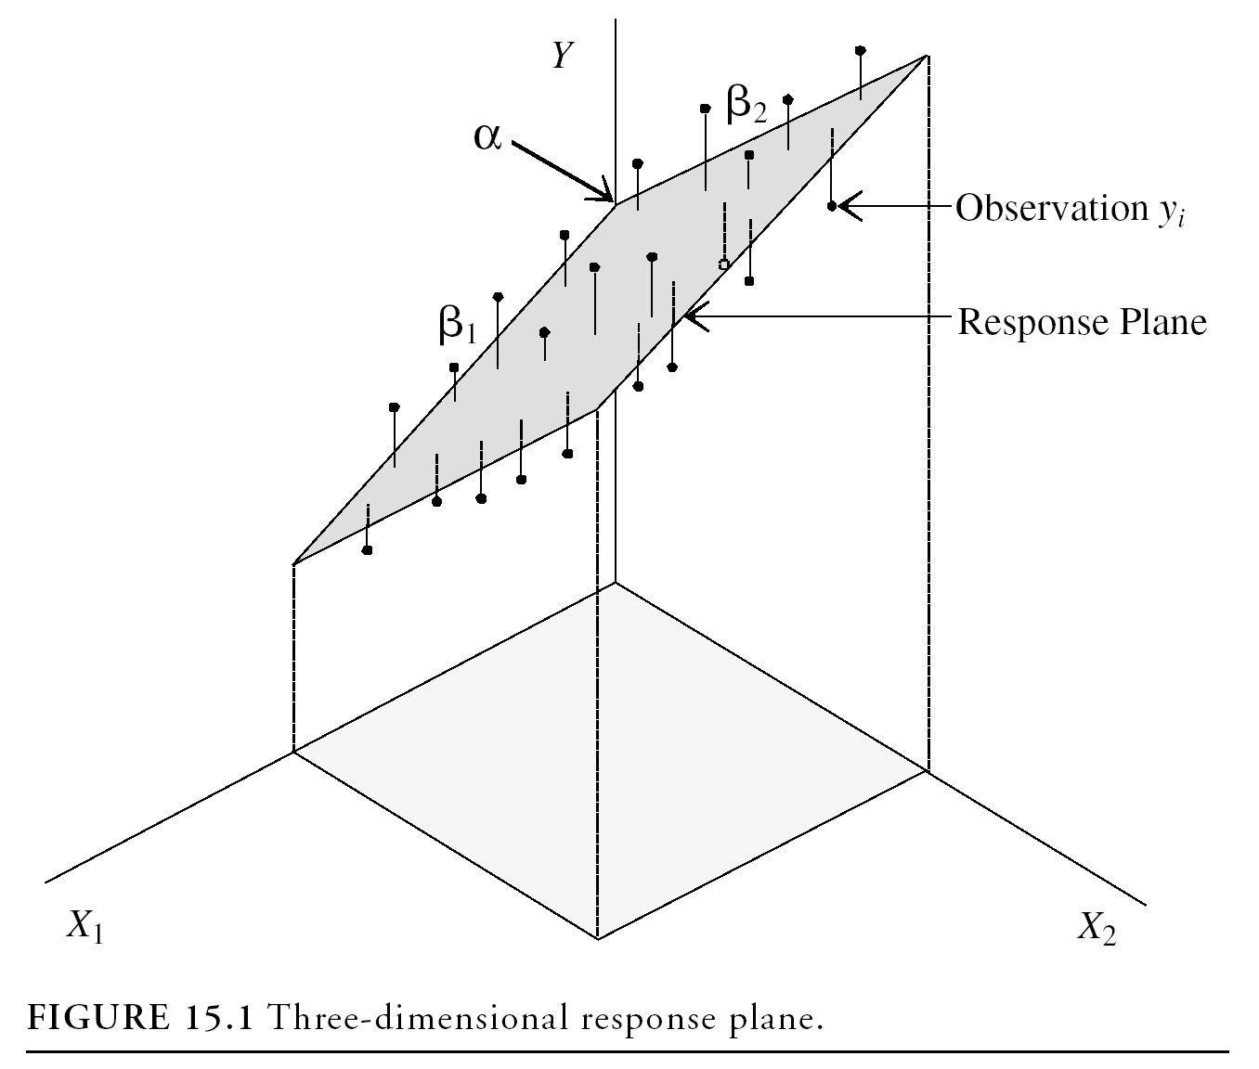
Multiple Regression Model
Intercept α predicts where the regression plane crosses the Y axis
Slope for variable X₁ (β₁) predicts the change in Y per unit X₁ holding X₂ constant
The slope for variable X₂ (β₂) predicts the change in Y per unit X₂ holding X₁ constant
Basic Biostat
15: Multiple Linear Regression

Slide 8

Multiple Regression Model
A multiple regression model with k independent variables fits a regression “surface” in k + 1 dimensional space (cannot be visualized)
Basic Biostat
15: Multiple Linear Regression

Slide 9
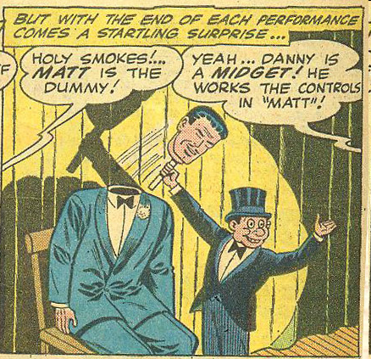
15.3 Categorical Explanatory Variables in Regression Models
Categorical independent variables can be incorporated into a regression model by converting them into 0/1 (“dummy”) variables
For binary variables, code dummies “0” for “no” and 1 for “yes”
Basic Biostat
15: Multiple Linear Regression

Slide 10
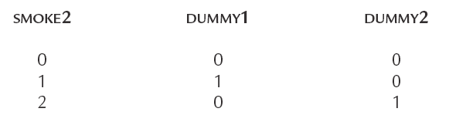
Dummy Variables, More than two levels
For categorical variables with k categories, use k–1 dummy variables
SMOKE2 has three levels, initially coded
0 = non-smoker
1 = former smoker
2 = current smoker
Use k – 1 = 3 – 1 = 2 dummy variables to code this information like this:
Basic Biostat
15: Multiple Linear Regression

Slide 11
Illustrative Example
Childhood respiratory health survey.
Binary explanatory variable (SMOKE) is coded 0 for non-smoker and 1 for smoker
Response variable Forced Expiratory Volume (FEV) is measured in liters/second
The mean FEV in nonsmokers is 2.566
The mean FEV in smokers is 3.277
Basic Biostat
15: Multiple Linear Regression

Slide 12
Example, cont.
Regress FEV on SMOKE least squares regression line:
ŷ = 2.566 + 0.711X
Intercept (2.566) = the mean FEV of group 0
Slope = the mean difference in FEV
= 3.277 − 2.566 = 0.711
Basic Biostat
15: Multiple Linear Regression

Slide 13
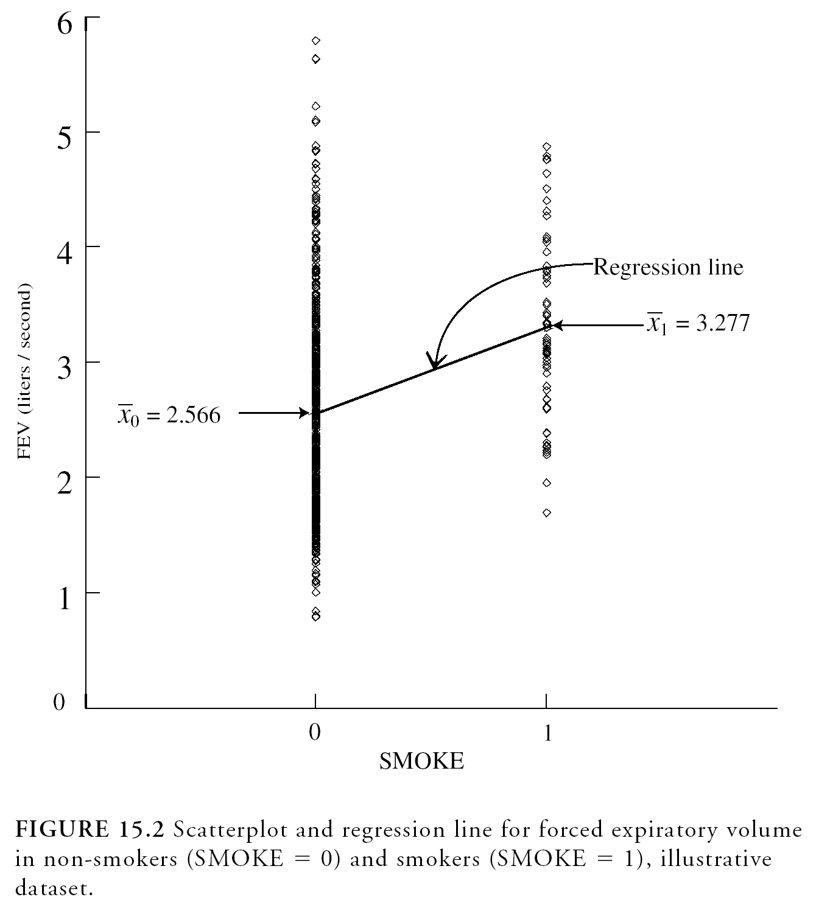
Dummy Variable SMOKE
b = 3.277 – 2.566 = 0.711
Regression line passes through group means
Basic Biostat
15: Multiple Linear Regression

Slide 14
Smoking increases FEV?
Children who smoked had higher mean FEV
How can this be true given what we know about the deleterious respiratory effects of smoking?
ANS: Smokers were older than the nonsmokers
AGE confounded the relationship between SMOKE and FEV
A multiple regression model can be used to adjust for AGE in this situation
Basic Biostat
15: Multiple Linear Regression

Slide 15
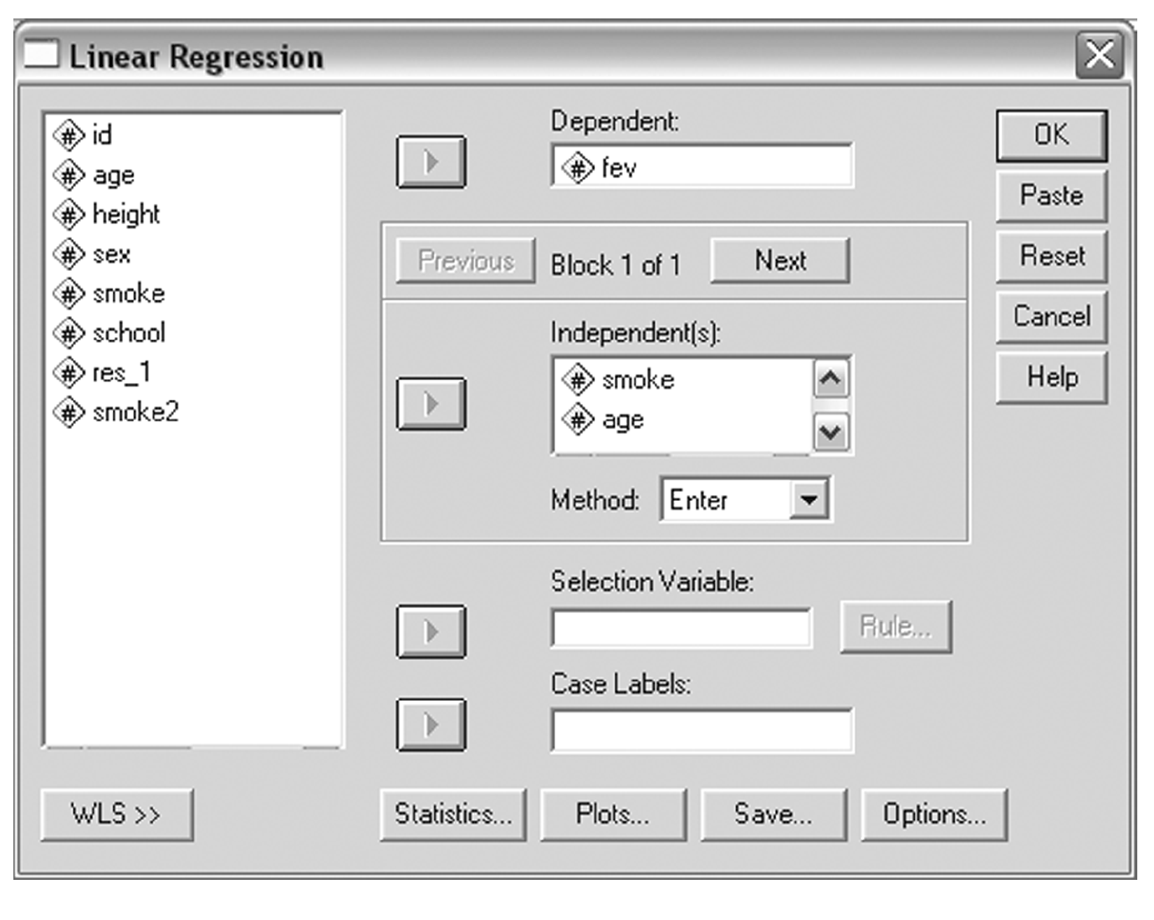
15.4 Multiple Regression Coefficients
Rely on software to calculate multiple regression statistics
Basic Biostat
15: Multiple Linear Regression

Slide 16
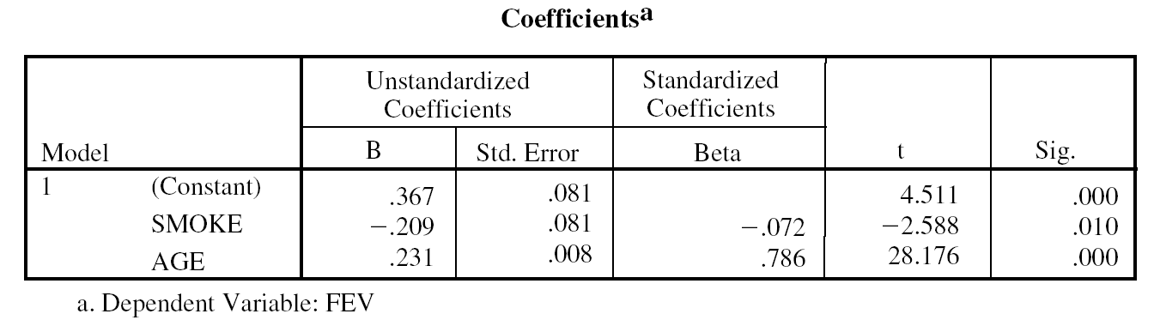
Example
SPSS output for our example:
Intercept a
Slope b₁
Slope b₂
The multiple regression model is:
FEV = 0.367 + −.209(SMOKE) + .231(AGE)
Basic Biostat
15: Multiple Linear Regression

Slide 17
Multiple Regression Coefficients, cont.
The slope coefficient associated for SMOKE is −.206, suggesting that smokers have .206 less FEV on average compared to non-smokers (after adjusting for age)
The slope coefficient for AGE is .231, suggesting that each year of age in associated with an increase of .231 FEV units on average (after adjusting for SMOKE)
Basic Biostat
15: Multiple Linear Regression

